Slide 1
Bank Data Analysis Using SQL
SHAIK MOHAMMED IKRAM

Slide 2
Table of contents
01
Introduction
03
Analysis By SQL
02
Project Setup
04
Concluson
Basic Intoduction Of The Project
A deep analysis of the data is done using SQL
Setting the datasets and schema for the analysis
Conclusion to the project

Slide 3
Introduction
This project focuses on analyzing the average balance per customer at the end of each month over the last year. By leveraging transaction and account data, the study aims to identify financial trends and customer behavior patterns. The insights derived can guide better customer engagement strategies and optimize banking services.

Slide 4
02
Project Setup

Slide 5
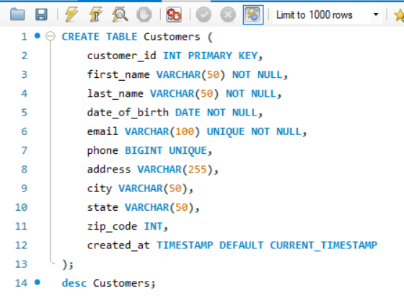
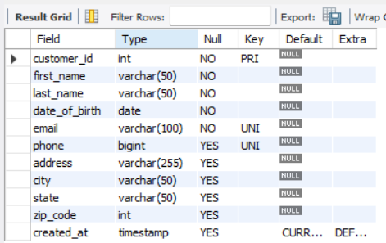
Customers Table

Slide 6
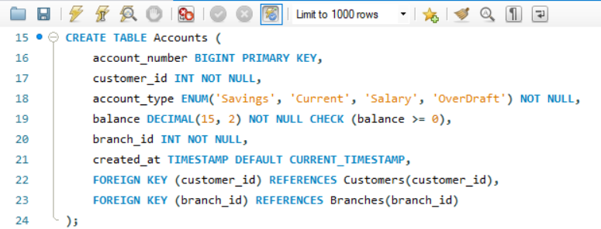
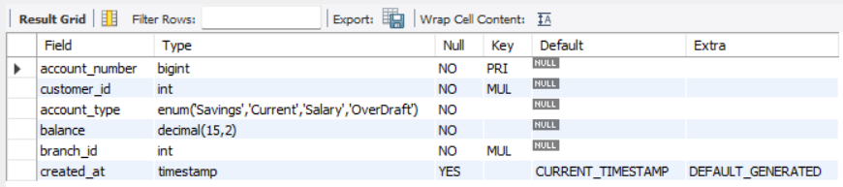
Accounts Table

Slide 7
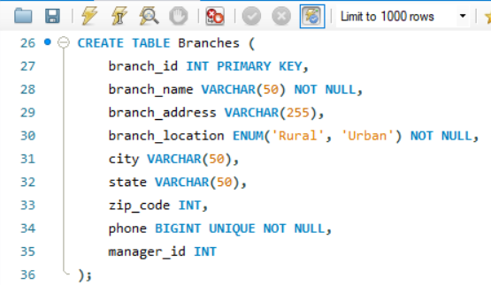
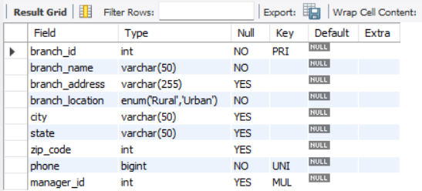
Branches Table

Slide 8
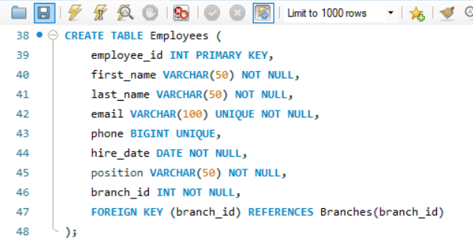
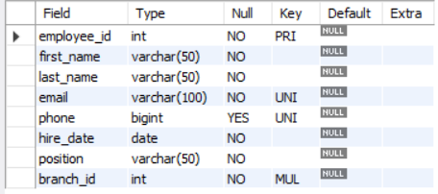
Employees Table

Slide 9
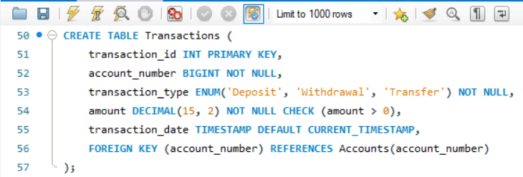
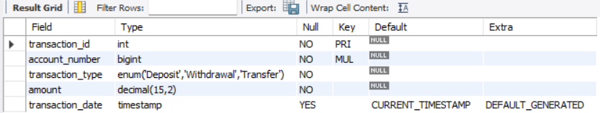
Transactions Table

Slide 10
03
Analysis Using SQL
A deep analysis using SQL is perfomed on the given datasets

Slide 11
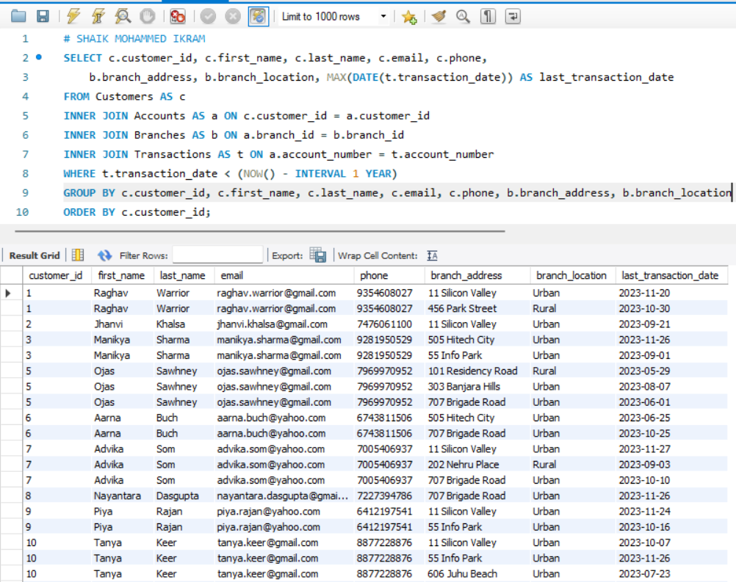
Q1.Write a query to list all customers who haven't made any transactions in the last year. How can we make them active again? Provide appropriate reason.

Slide 12
Insights Found
Inactive Customers:
The query reveals a list of customers who have not been active in over a year.
This inactivity could result from a lack of engagement or switching to other banks.
Regional Insights:
Branch location (Urban or Rural) provides context for designing targeted reactivation strategies.
Urban customers may require digital engagement, while rural customers might benefit from in-person outreach.
Potential Strategies to Reactivate Customers:
Offer promotional schemes such as cashback or rewards for transactions.
Conduct personalized outreach via email or phone, highlighting bank benefits.
Enhance branch services to cater to the specific needs of inactive customers based on their location.

Slide 13
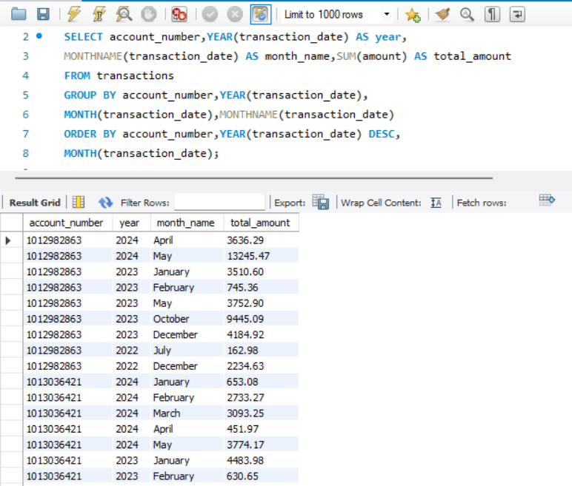
Q2.Summarize the total transaction amount per account per month.

Slide 14
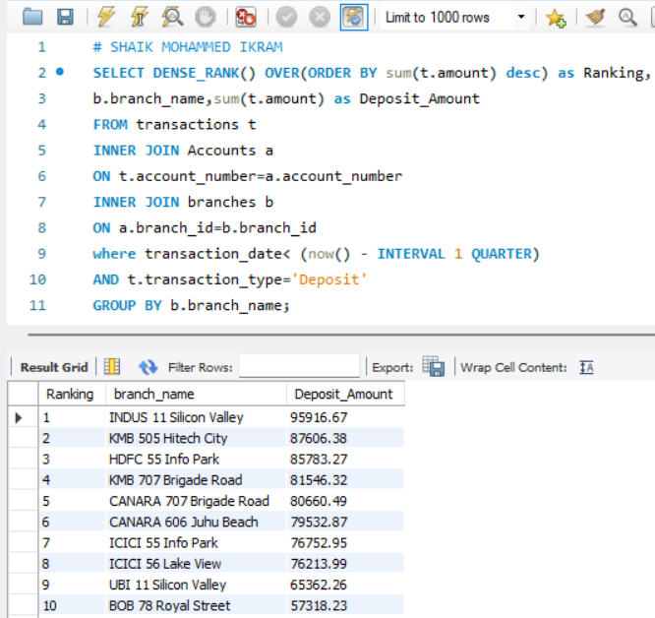
Q3.Rank branches based on the total amount of deposits made in the last quarter.

Slide 15
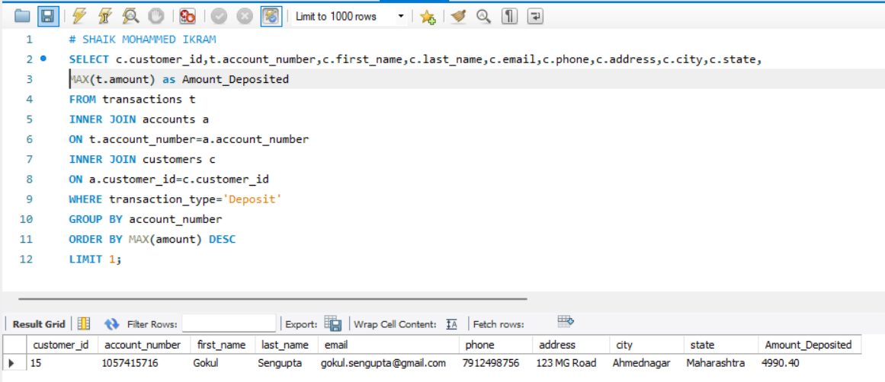
Q4. Find the name of the customer who has deposited the highest amount.

Slide 16
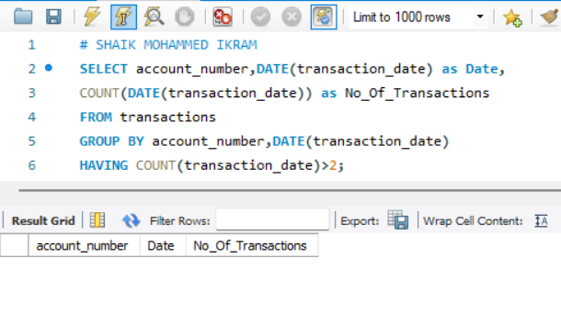
Q5. Identify any accounts that have made more than two transactions in a single day, which could indicate fraudulent activity. Howcan you verify any fraudulent transaction?

Slide 17
Insights Found
Potential Fraudulent Accounts:
Accounts making frequent transactions in a single day might indicate suspicious activity, such as unauthorized access or malicious intent.
Regularly monitoring such accounts can help reduce fraud risk.
Behavior Patterns:
Some flagged cases might reflect legitimate high activity, such as business accounts or emergency situations.
Differentiating between normal and suspicious activity requires additional context.
Mitigation Measures:
Implement Transaction Limits: Cap the number of transactions allowed per day.
Strengthen Authentication: Require additional verification for frequent transactions.
AI Fraud Detection Systems: Use predictive models to identify and prevent fraudulent transactions.

Slide 18
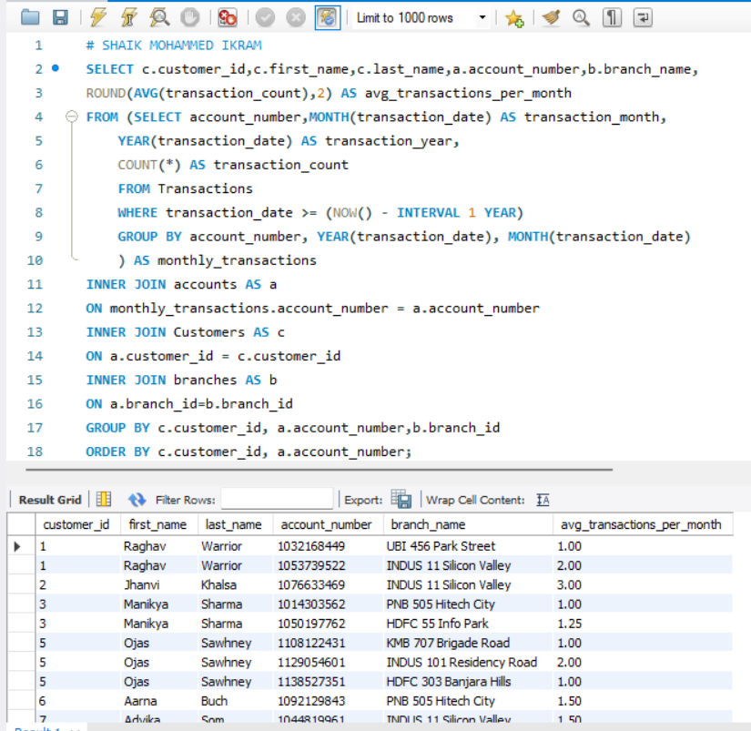
Q6. Calculate the average number of transactions per customer per account per month over the last year.

Slide 19
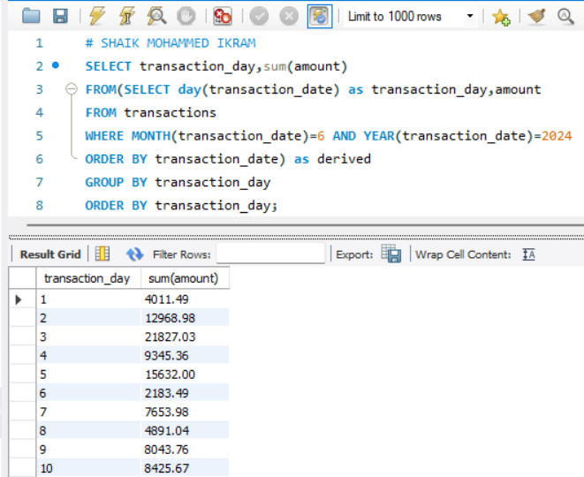
Q7. Write a query to find the daily transaction volume (total amount of all transactions) for the past month.

Slide 20
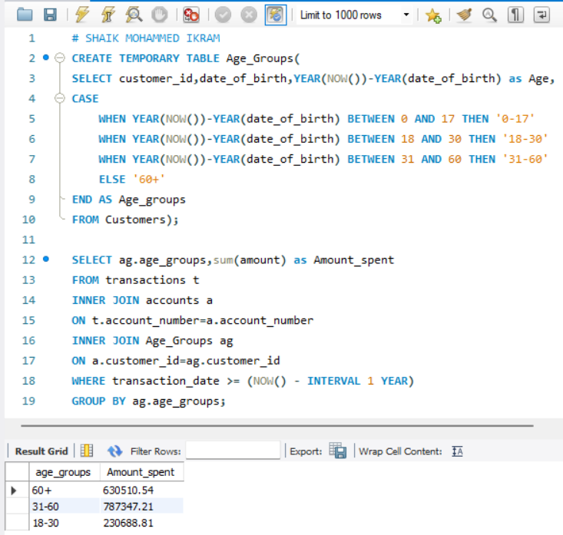
Q8. Calculate the total transaction amount performed by each age group in the past year. (Age groups: 0-17, 18-30, 31-60, 60+)

Slide 21
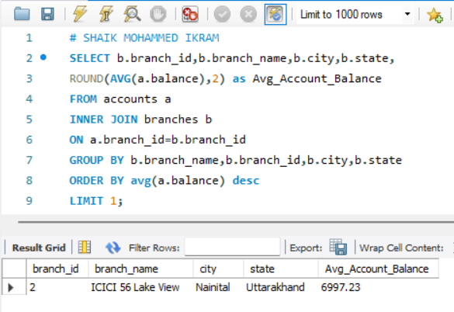
Q9. Find the branch with the highest average account balance.

Slide 22
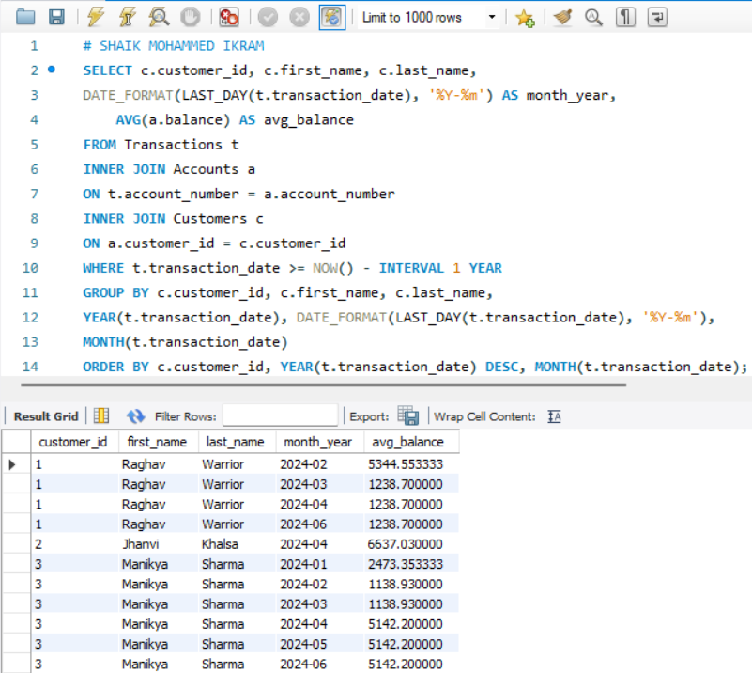
Q10. Calculate the average balance per customer at the end of each month in the last year.

Slide 23
Conclusion:
This project successfully identified key customer behaviors, transaction patterns, and potential risks, such as inactive accounts and high-frequency transactions. Insights derived can enhance customer engagement, mitigate fraudulent activity, and optimize banking operations. These findings pave the way for data-driven strategies to improve financial services.

Slide 24
Thanks!
Feel Free Checkout The Complete
Project On Github:
https://github.com/Ikram-Shaik/Bank_Data_Anlaysis_SQL

